Slide 1
Data Analytics: Module-1
Dr. Ramen Pal Associate Professor Department of CSE (AI & ML), UEMK
Contact: ramen.pal@uem.edu.in WhatsApp: 7501038078

Slide 2
Course Details
Subject Name: Professional Elective - III : Data Analytics
Credit: 3
Subject Code: PECCSE602A
Lecture Hours: 36

Slide 3
Course Outcome
On completion of the course students will be able to:
CO-1: Discuss with illustration the techniques and methods related to the area of data collection, pre-processing, and exploratory data analytics.
CO-2: Discuss important terms and techniques on statistics to enable student to understand the background of different tools or methods used in data analytics.
CO-3: Use at beginning level of proficiency on the tools of machine learning to ask questions of and explore patterns in data.
CO-4: Demonstrate intermediate proficiency in the visualization of data to communicate information and patterns that exist in the data.

Slide 4
Syllabus: Module-1 (Introduction to Data Analytics)
Data science workflow, Automated methods for data collection, Data and Visualization Models, Data wrangling and cleaning, Exploratory data analysis, Dimensionality Reduction. Building and evaluation of models for: Association Analysis, Recommendation Systems, Time-series data, Text Analysis, Data Mining.

Slide 5
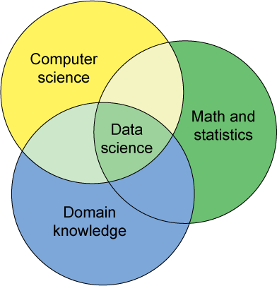
Data Science – One Definition

Slide 6

DB-hard Queries
Company_Name | Address | Market Cap
Google | Googleplex, Mtn. View, CA | $210Bn
Intl. Business Machines | Armonk, NY | $200Bn
Microsoft | Redmond, WA | $250Bn
SELECT Market_Cap
From Companies
Where Company_Name = “Apple”
Number of Rows: 0
Problem:
Missing Data

Slide 7
DB-hard Queries
Company_Name | Address | Market Cap
Google | Googleplex, Mtn. View, CA | $210Bn
Intl. Business Machines | Armonk, NY | $200Bn
Microsoft | Redmond, WA | $250Bn
SELECT Market_Cap
From Companies
Where Company_Name = “IBM”
Number of Rows: 0
Problem:
Entity Resolution
Notes:
For the database administrator it is the correct answer, but for the CEO it is not really understandable

Slide 8
DB-hard Queries
Company_Name | Address | Market Cap
Google | Googleplex, Mtn. View | $210
Intl. Business Machines | Armonk, NY | $200
Microsoft | Redmond, WA | $250
Sally’s Lemonade Stand | Alameda,CA | $260
SELECT MAX(Market_Cap)
From Companies
Number of Rows: 0
Problem:
Unit Mismatch
Notes:
For the database administrator it is the correct answer, but for the CEO it is not really understandable

Slide 9

Who’s Calling Who’S Data Dirty?

Slide 10
Dirty Data
Dirty data, or unclean data or rogue data, is data that is in some way faulty: it might contain duplicates, or be outdated, insecure, incomplete, inaccurate, or inconsistent.
The Statistics View:
There is a process that produces data
Any dataset is a sample of the output of that process
Results are probabilistic
You can correct bias in your sample

Slide 11
Dirty Data
The Database View:
I got my hands on this data set
Some of the values are missing, corrupted, wrong, duplicated
You get a better answer by improving the quality of the values in your dataset

Slide 12
Dirty Data
The Domain Expert’s View:
This Data Doesn’t look right
This Answer Doesn’t look right
What happened?

Slide 13
Dirty Data
The Data Scientist’s View:
Some Combination of all of the above

Slide 14
Data Quality Problems
Data is dirty on its own
Datasets are clean but suffer “bit rot”
Old data loses its value over time
Datasets are clean but integration (i.e., combining them) screws them up
Any combination of the above

Slide 15
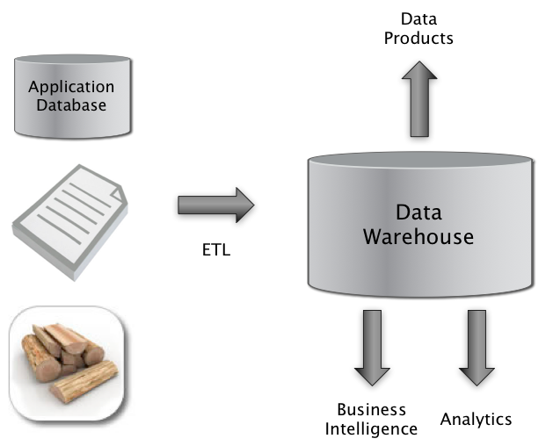

Big Picture: Where can Dirty Data Arise?
Integrate
Clean
Extract
Transform
Load

Slide 16
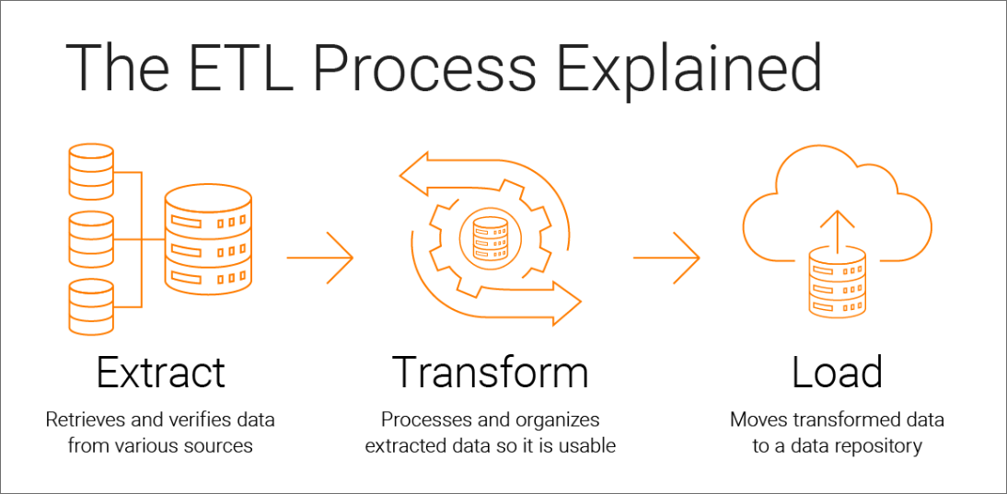
ETL

Slide 17
Example Data Quality Problems
T.Das|97336o8327|24.95|Y|-|0.0|1000
Ted J.|973-360-8779|2000|N|M|NY|1000
Can we interpret the data?
What do the fields mean?
What is the key?
Data glitches
Typos, multiple formats, missing / default values
Metadata and domain expertise
Field three is Revenue. In dollars or rupees?
Field four is Usage. Is it censored or uncensored?
Field 4 is a censored flag. How to handle censored data?

Slide 18
Data Glitches
Systemic changes to data which are external to the recorded process.
Changes in data layout / data types
Integer becomes string, fields swap positions, etc.
Changes in scale / format
Dollars vs. euros
Temporary reversion to defaults
Failure of a processing step
Missing and default values
Application programs do not handle NULL values well …
Gaps in time series
Especially when records represent incremental changes.

Slide 19
Dirty Data Problems
From Stanford Data Integration Course:
Naming conventions: Eg: NYC vs New York
Missing required field (Eg: key field)
Different representations (Eg: 2 vs Two)
Fields too long (get truncated)
Primary key violation (from unsturctured to structured or during integration)
Redundant Records (exact match or other)
Formatting issues – Eg: dates
Licensing issues/Privacy/ keep you from using the data as you would like?

Slide 20
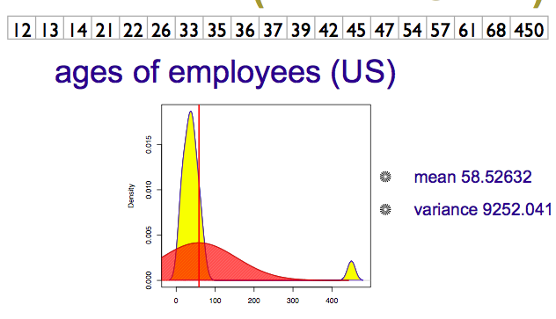

Numeric Outliers

Slide 21
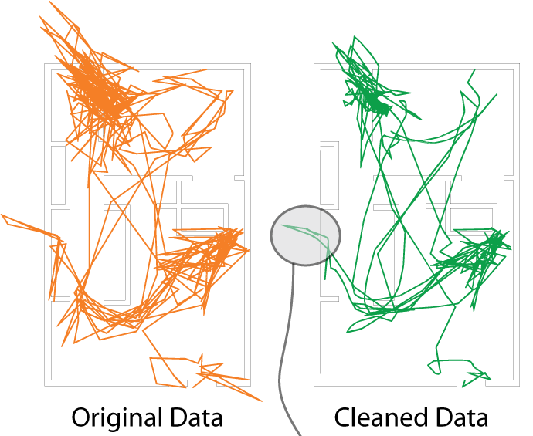
Tracking Superman @ home?
Ubisense tracking data
He walks through walls;
He flies across the room…
Too much
cleaning
and you
lose detail.

Slide 22
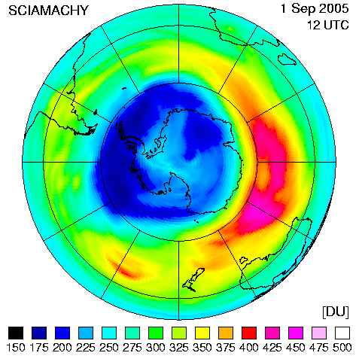
Data Cleaning Makes Everything Okay?
The appearance of a hole in the earth's ozone layer over Antarctica, first detected in 1976, was so unexpected that scientists didn't pay attention to what their instruments were telling them; they thought their instruments were malfunctioning.
National Center for Atmospheric Research
In fact, the data were rejected as unreasonable by data quality control algorithms

Slide 23
How Clean is “clean-enough”?
How much cleaning is too much?
Answers are likely to be:
domain-specific
data source-specific
application-specific
user-specific
all of the above?

Slide 24
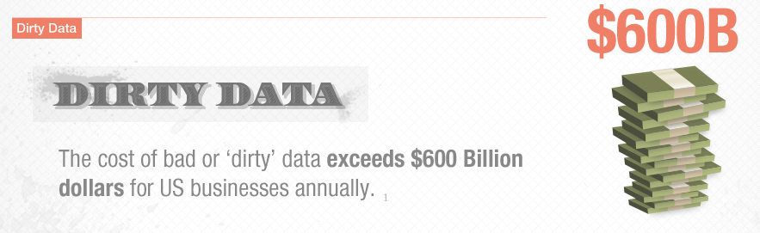
Data Quality
from http://www-new.insightsquared.com/wp-content/uploads/2012/01/insightsquared_dq_infographic-2.png

Slide 25
Meaning of Data Quality (1)
Generally, you have a problem if the data doesn't mean what you think it does, or should
Data not up to spec : garbage in, glitches, etc.
You don’t understand the spec : complexity, lack of metadata.
Many sources and manifestations
As we have discussed
Data quality problems are expensive and pervasive
DQ problems cost hundreds of billion $$$ each year.
Resolving data quality problems is often the biggest effort in a data mining study.
Notes:
Many sources and manifestations make definitions difficult.
But it is necessary to get a grip on the problem because … expensive and pervasive.

Slide 26
Conventional Definition of Data Quality: Metrics
Accuracy
The data was recorded correctly.
Completeness
All relevant data was recorded.
Uniqueness
Entities are recorded once.
Timeliness
The data is kept up to date.
Special problems in federated data: time consistency.
Consistency
The data agrees with itself.

Slide 27
Problems
Unmeasurable
Accuracy and completeness are extremely difficult, perhaps impossible to measure.
Context independent
No accounting for what is important. E.g., if you are computing aggregates, you can tolerate a lot of inaccuracy.
Incomplete
What about interpretability, accessibility, metadata, analysis, etc.
Vague
The conventional definitions provide no guidance towards practical improvements of the data.

Slide 28
Meaning of Data Quality (2)
There are many types of data, which have different uses and typical quality problems
Federated data
High dimensional data
Descriptive data
Longitudinal data
Streaming data
Web (scraped) data
Adapted from Ted Johnson’s SIGMOD 2003 Tutorial

Slide 29
Meaning of Data Quality (2)
There are many uses of data
Operations
Aggregate analysis
Customer relations …
Data Interpretation: the data is useless if we don’t know all of the rules behind the data.
Data Suitability: Can you get the answer from the available data
Use of proxy data
Relevant data is missing
Notes:
Challenge in operations : many handoffs. Some processes more important than others.
Challenge in aggregate analysis: can tolerate errors, but you’re summing up over a lot of data, therefore likely to add in glitched data.
Customer relations : the fields must be accurate, but errors don’t spread.

Slide 30
The Data Quality Continuum
Data and information is not static, it flows in a data collection and usage process
Data gathering
Data storage
Data integration
Data retrieval
Data delivery
Data mining/analysis

Slide 31
Data Gathering
How does the data enter the system?
Sources of problems:
Manual entry
No uniform standards for content and formats
Parallel data entry (duplicates)
Approximations, surrogates – SW/HW constraints
Measurement errors.
Adapted from Ted Johnson’s SIGMOD 2003 Tutorial
Notes:
MPDS workshop, John Bates

Slide 32
Solutions
Potential Solutions:
Preemptive:
Process architecture (build in integrity checks)
Process management (reward accurate data entry, data sharing, data stewards)
Retrospective:
Cleaning focus (duplicate removal, merge/purge, name & address matching, field value standardization)
Diagnostic focus (automated detection of glitches).

Slide 33
Internet of Things has Special Problems
RFID data has many dropped readings
Typically, use a smoothing filter to interpolate
SELECT distinct tag_id
FROM RFID_stream [RANGE ‘7 sec’]
GROUP BY tag_id
Smoothed output
Smoothing Filter
Raw readings
Time

Slide 34
Tracking Superman @ home?
Ubisense tracking data
He walks through walls;
He flies across the room…
Too much
cleaning
and you
lose detail.

Slide 35
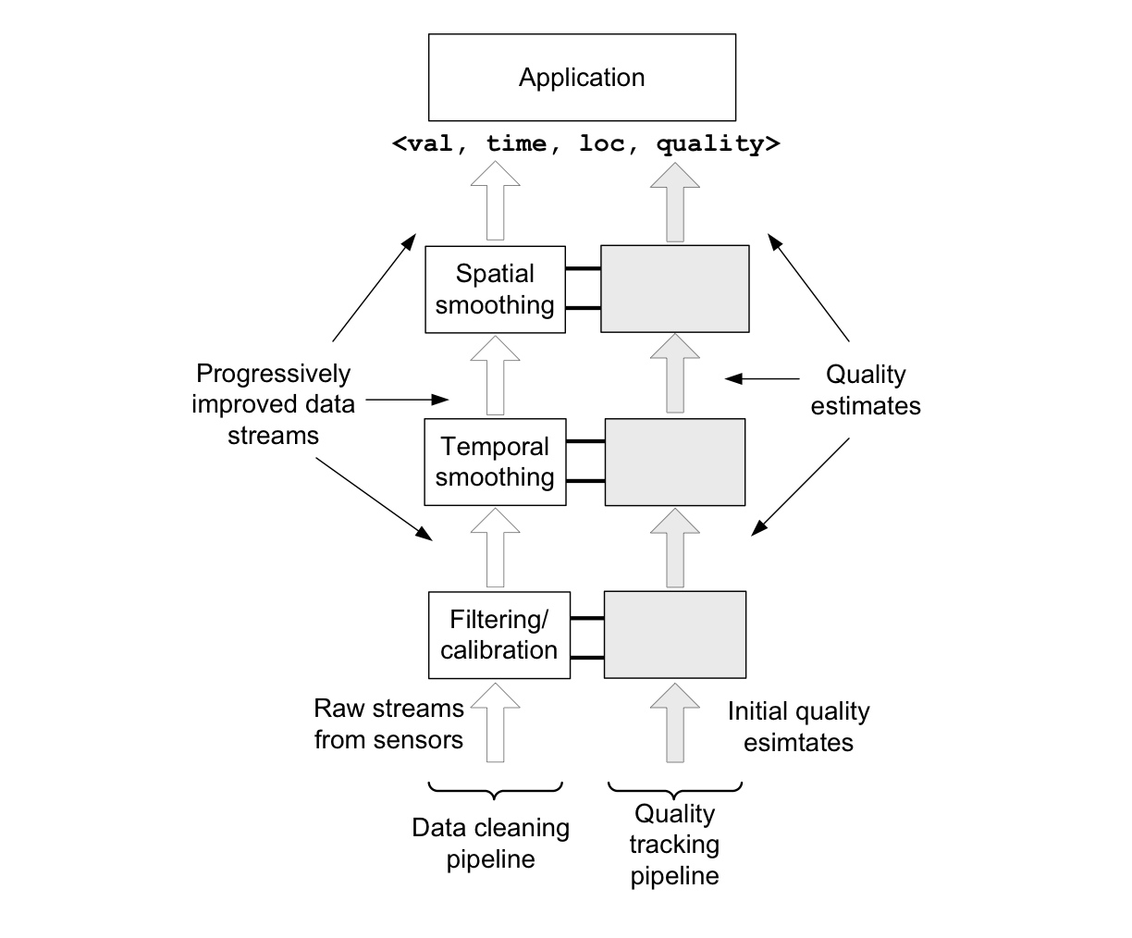
Adding Quality Assessment

Slide 36
EDA

Slide 37
WHAT IS EDA (Exploratory Data Analytics)?
The analysis of datasets based on various numerical methods and graphical tools.
Exploring data for patterns, trends, underlying structure, deviations from the trend, anomalies and strange structures.
It facilitates discovering unexpected as well as conforming the expected.
Another definition: An approach/philosophy for data analysis that employs a variety of techniques (mostly graphical).

Slide 38
AIM OF THE EDA
Maximize insight into a dataset
Uncover underlying structure
Extract important variables
Detect outliers and anomalies
Test underlying assumptions
Develop valid models
Determine optimal factor settings

Slide 40
AIM OF THE EDA
The goal of EDA is to open-mindedly explore data.
Tukey: EDA is detective work… Unless detective finds the clues, judge or jury has nothing to consider.
Here, judge or jury is a confirmatory data analysis
Tukey: Confirmatory data analysis goes further, assessing the strengths of the evidence.
With EDA, we can examine data and try to understand the meaning of variables. What are the abbreviations stand for.

Slide 41
Exploratory vs Confirmatory Data Analysis
EDA | CDA
No hypothesis at first Generate hypothesis Uses graphical methods (mostly) | Start with hypothesis Test the null hypothesis Uses statistical models

Slide 42
STEPS OF EDA
Generate good research questions
Data restructuring: You may need to make new variables from the existing ones.
Instead of using two variables, obtaining rates or percentages of them
Creating dummy variables for categorical variables
Based on the research questions, use appropriate graphical tools and obtain descriptive statistics. Try to understand the data structure, relationships, anomalies, unexpected behaviors.
Try to identify confounding variables, interaction relations and multicollinearity, if any.
Handle missing observations
Decide on the need of transformation (on response and/or explanatory variables).
Decide on the hypothesis based on your research questions

Slide 43
AFTER EDA
Confirmatory Data Analysis: Verify the hypothesis by statistical analysis
Get conclusions and present your results nicely.

Slide 44
Classification of EDA*
Exploratory data analysis is generally cross-classified in two ways. First, each method is either non-graphical or graphical. And second, each method is either univariate or multivariate (usually just bivariate).
Non-graphical methods generally involve calculation of summary statistics, while graphical methods obviously summarize the data in a diagrammatic or pictorial way.
Univariate methods look at one variable (data column) at a time
Bivariate EDA look at exactly two variables.
Multivariate methods look at more than two variables at a time to explore relationships.
It is almost always a good idea to perform univariate EDA on each of the components before performing the multivariate EDA.
*Seltman, H.J. (2015). Experimental Design and Analysis. http://www.stat.cmu.edu/~hseltman/309/Book/Book.pdf

Slide 45
Graphical Methods
Univariate: Looking at one variable/column at a time
Bar-graph
Histograms
Boxplot
Multivariate : Looking at relationship between two or more variables
Scatter plots
Pie plots
Heatmaps(seaborn)

Slide 46
EXAMPLE 1
In a breast cancer research, main questions of interest might be
Does any treatment method result in a higher survival rate? Can a particular treatment be suggested to a woman with specific characteristic?
Is there any difference between patients in terms of survival rates (e.g. Are white woman more likely to survive compare the black woman if they are both at the same stage of disease?)

Slide 47
EXAMPLE 2*
New cancer cases in the U.S. based on a cancer registry
• The rows in the registry are called observations they correspond to individuals
• The columns are variables or data fields they correspond to attributes of the individuals
https://www.biostat.wisc.edu/~lindstro/2.EDA.9.10.pdf

Slide 48
EDA Part 2: Summarizing Data With Tables and Plots
Examine the entire data set using basic techniques before starting a formal statistical analysis.
Familiarizing yourself with the data.
Find possible errors and anomalies.
Examine the distribution of values for each variable.

Slide 49
Examples of Variables
Identifier(s):
- patient number,
- visit # or measurement date (if measured more than once)
Attributes at study start (baseline):
- enrollment date,
- demographics (age, BMI, etc.)
- prior disease history, labs, etc.
- assigned treatment or intervention group
- outcome variable
Attributes measured at subsequent times
- any variables that may change over time
- outcome variable

Slide 50
Categorical Data Summaries
Tables
Cancer site is a variable taking 5 values
categorical or continuous?
ordered or unordered?

Slide 51
Frequency Table
Frequency Table: Categories with counts
Relative Frequency Table: Percentage in each category

Slide 52
Graphing a Frequency Table - Bar Chart:
Plot the number of observations in each category:

Slide 53
Continuous Data - Tables
Example: Ages of 10 adult leukemia patients:
35; 40; 52; 27; 31; 42; 43; 28; 50; 35
One option is to group these ages into decades and create a categorical age variable:

Slide 54
Continuous Data - Tables
We can then create a frequency table for this new categorical age
variable.

Slide 55
EDA

